Slide 1

My Something Awesome Project : VAN’s advanced keylogger
Vandana Rao Emaneni
z5451278

Slide 2
SUMMARY
Why did I choose this topic? – Understand and implement the working of a keylogger with added functionalities
Keystrokes
Screenshots
System Information
Audio

Slide 3
SUMMARY
3 best things I achieved that I am proud of –
Coding with complex python libraries
Implementation of audio capture
Setting up & Integration with Twilio remote server
Implementation of added layer of security – encryption & decryption
Hurdles I faced –
Sending key logs via EMAIL
Implementation of capturing clipboard data

Slide 4
SUMMARY
Challenges I faced–
Understanding & implementing different python libraries
Understanding & implementing integration with Twilio remote data server
Implementation of audio capture
Time Management

Slide 5
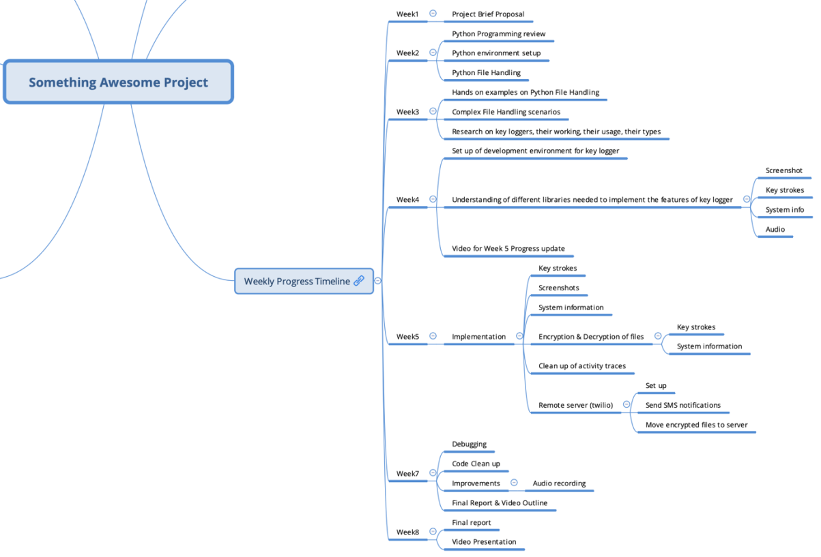
TIMELINE

Slide 6
Thank you!

